Slide 1
The Design of an AC-dc power supply for welding machines
Senior Design Project
By Iragena Bangamwabo
Student -Electrical Engineering

Slide 2
Outline
Introduction
Objective
Project Description
Design Requirements
Design Constraints
Design Approach
Tasks
Timeline
Implementation of Tasks

Slide 3
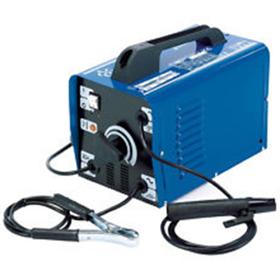

Introduction
A welding power supply is a device that provides electric current to perform a fusion of materials(usually metals or thermoplastics) by melting them, which requires a high current and high voltage.
Notes:
The focuses this project is to design a circuit that will serve as a power supply to in a welding machine.

Slide 4
Objective
The objective of this project is to design a power supply that will take a wide range of AC input voltage and convert it into a steady DC output voltage.
Notes:
The objective of this project is to develop a power supply that will take a wide range of AC input voltage and convert it into a steady DC output voltage.

Slide 5
Design Requirements
AC input voltage range: 120V – 600V
Single/three phase
DC output voltage: 285V
Output current: 50A
A circuit protection mechanism

Slide 6
Constraints
Budget – Estimated $1000 based on:
Materials
Supplies
Equipment
Limited Resources
High voltage power source
Software for design and simulation purposes

Slide 7
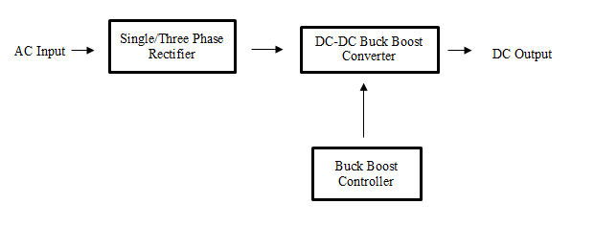
Design Approach

Slide 8
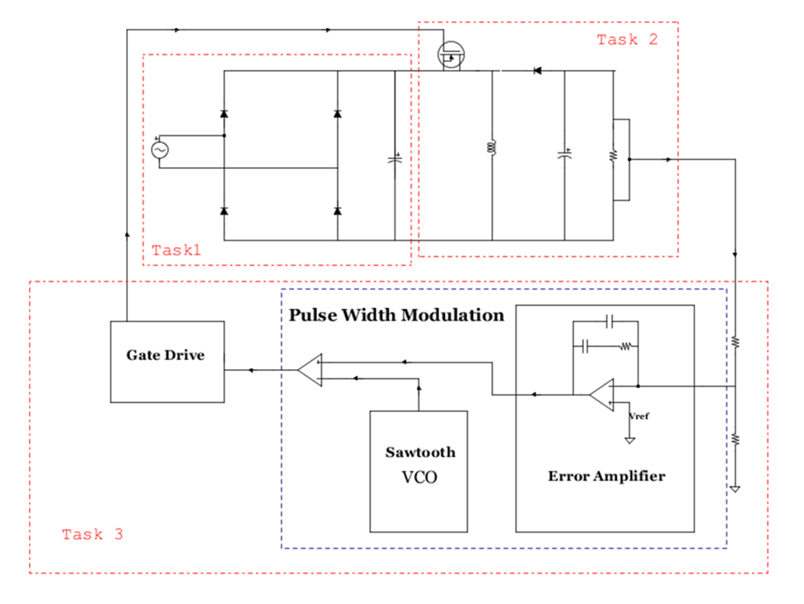
Implementation Plan
Tasks
System Diagram
Task 1. Design the AC-DC Rectifier
Task 2. Design a DC-DC converter
Subtask 1. Buck-Boost Converter Analysis
Subtask 2. Transfer function
Task 3. Design a control unit for the power supply
Subtask 1. Design the compensator
Subtask 2. Design a Voltage control Oscillator
Subtask 3. design a Gate drive
Task 4. whole system simulation
Subtask 1. Electronically simulate the functionality of the circuit
Subtask 2. make necessary adjustment
Task 5. Build the circuit
Subtask 1. Design the PCB
Subtask 2. Perform soldering

Slide 9
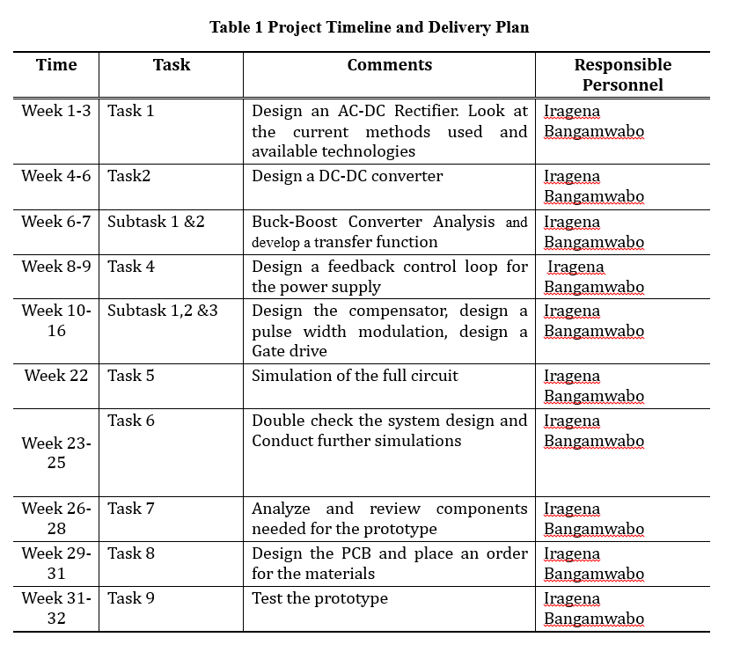
Timeline

Slide 10
Implementation of task 1
Design of an a C-DC rectifier

Slide 11
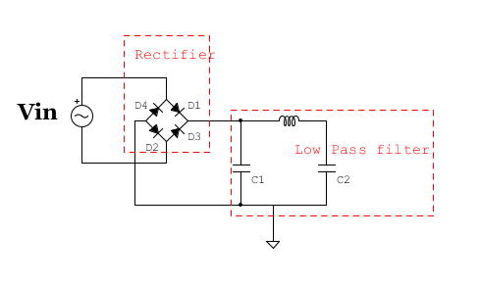
Rectifier System Diagram
When the positive half cycle of the supply D1, D2 diodes conducts in a series while diodes D3 and D4 are reverse biased.
During the negative half cycle, D3 and D4 diodes conduct in a series and diodes D1 and D2 switch off as they are now reverse biased configuration
The low pass filter is used to filter the output waveform due to high ripple effect of the DC output from the rectifier
Notes:
The series inductor presents high impedance at the ripple current frequency.

Slide 12
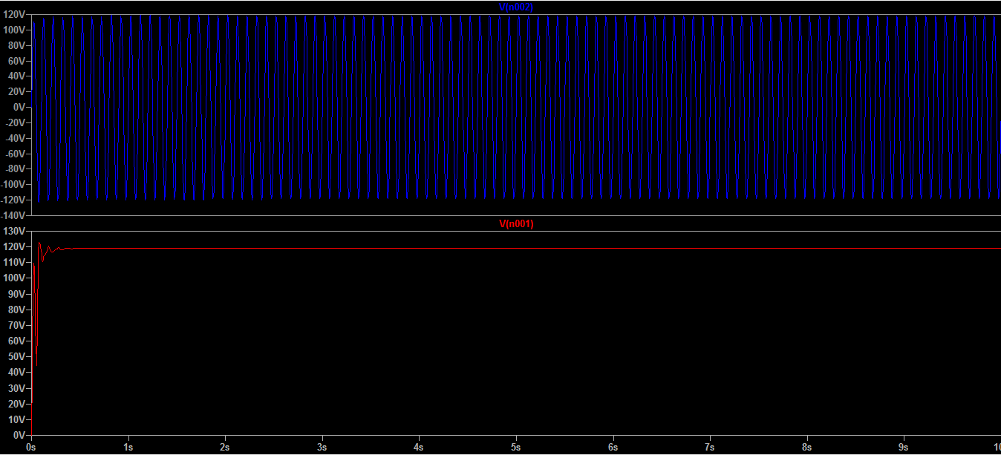
Simulation Results
Input Vs output wave form after low pass filter

Slide 13
Implementation of Task 2
Design of DC-DC converter

Slide 14
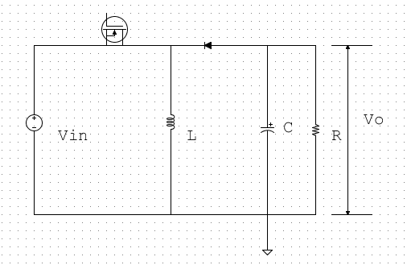
System Requirements
The converter will operate in DC steady state under the following conditions:
V-in = 120V_RMS
V_o = 285V
P_o = 14.4KW
f_S = 200kHz

Slide 15
Calculating components values

Slide 16

Calculations continues…

Slide 17
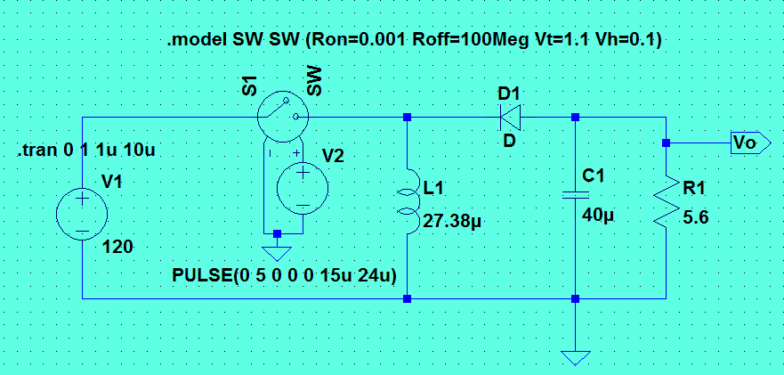
Spice Simulation
The circuit model shown below with calculated components values will be used for a SPICE simulation of the Buck-boost power supply

Slide 18
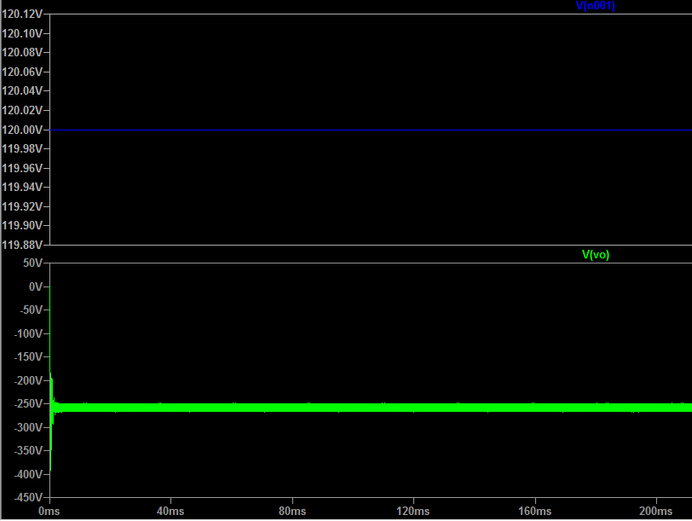
Voltage output
Voltage Input vs Voltage output

Slide 19
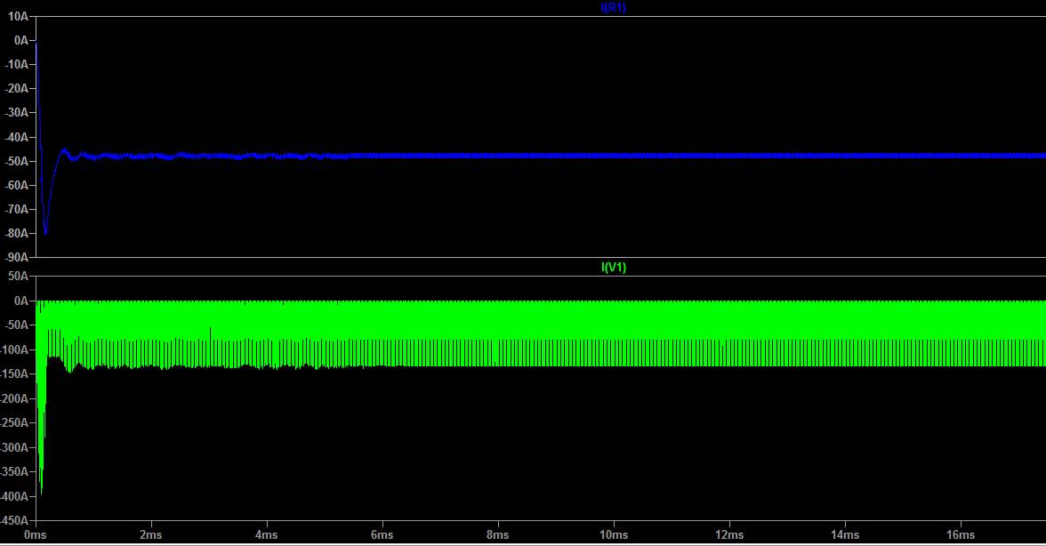
Input Current vs Output Current

Slide 20
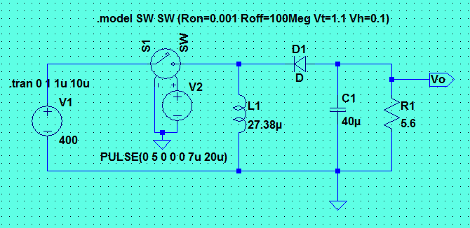
Simulation with different input voltage
Vin = 400V

Slide 21
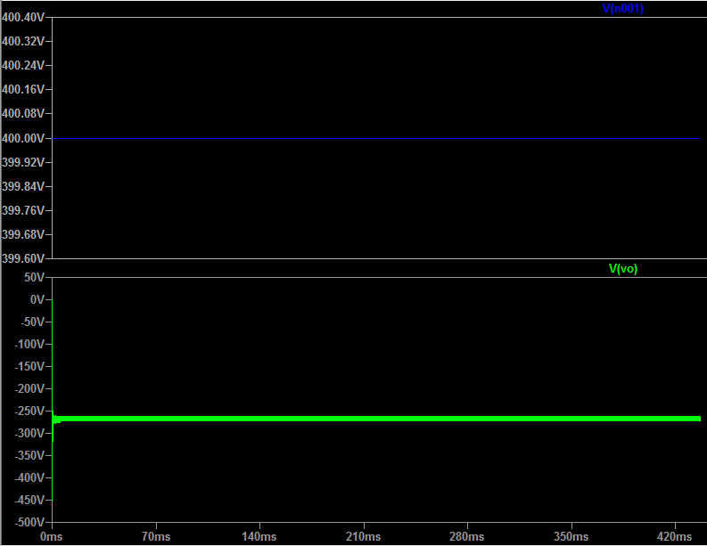
Simulation results
Output = 285V

Slide 22
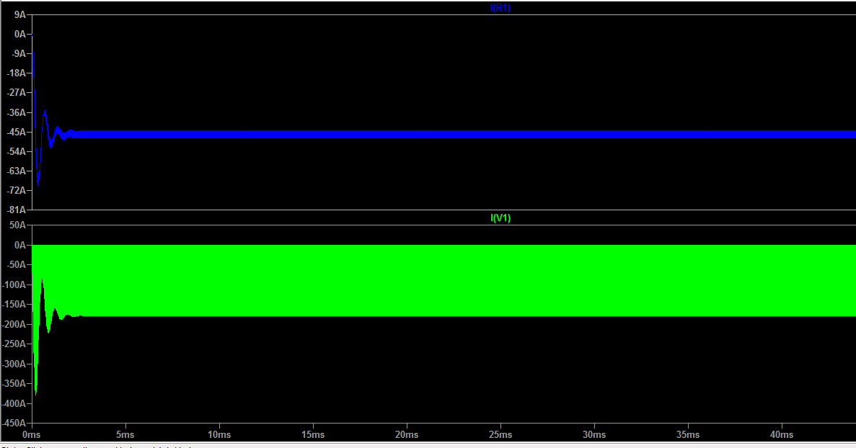
Input Current vs Output Current

Slide 23
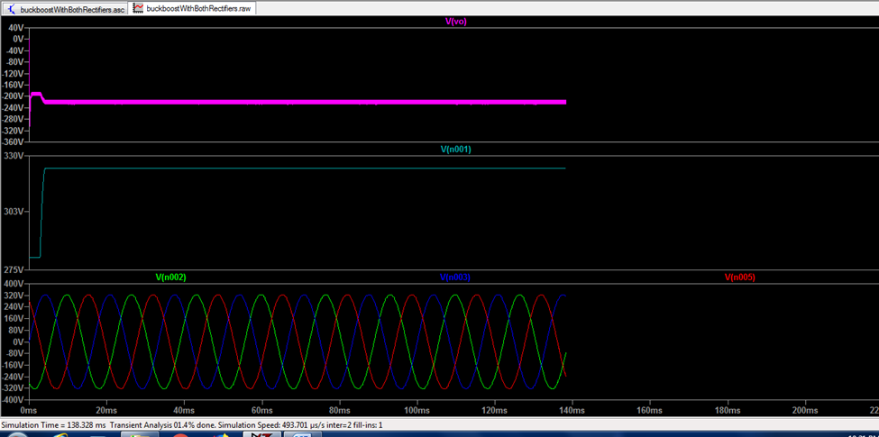
Simulation Results with 3 phases

Slide 24
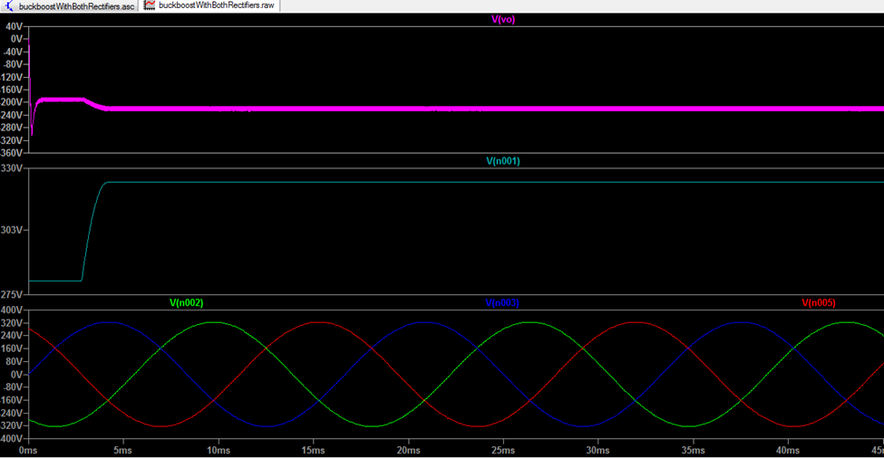
Three phase rectifier output

Slide 25
Implementation of task 3
Design of the control Unit

Slide 26
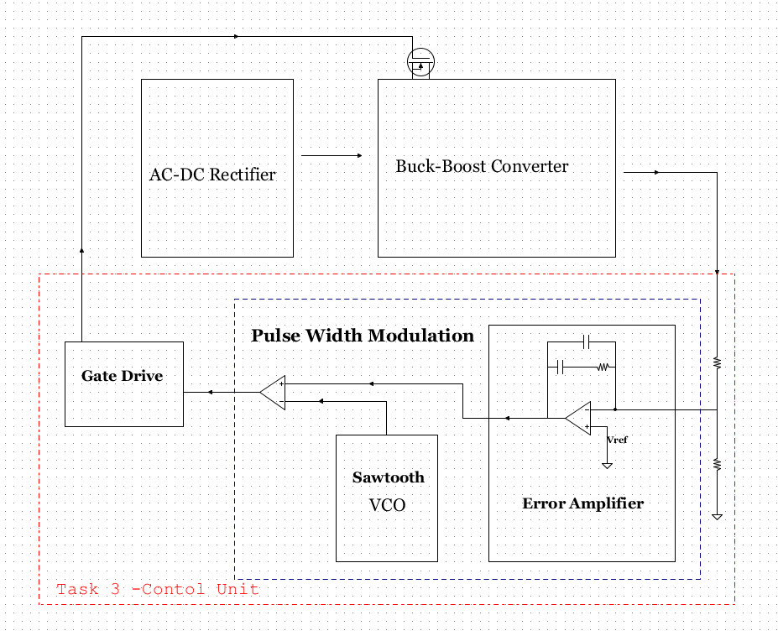
Block Diagram

Slide 27
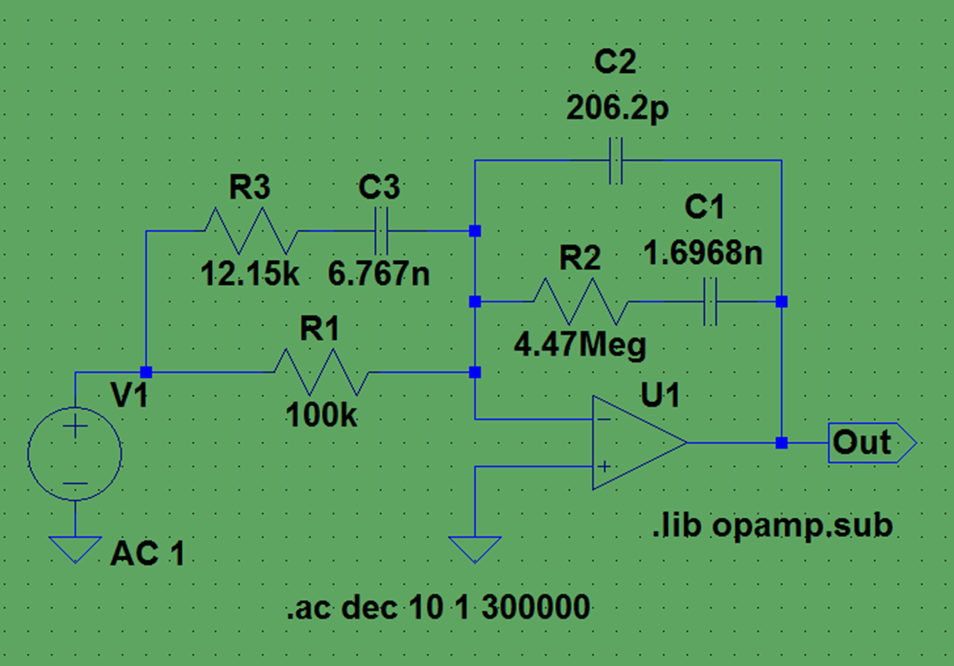
Error Amplifier
The purpose of this error amplifier is to counteract gains and phases contained in the out put of the buck boost converter that could jeopardize the stability of the system

Slide 28
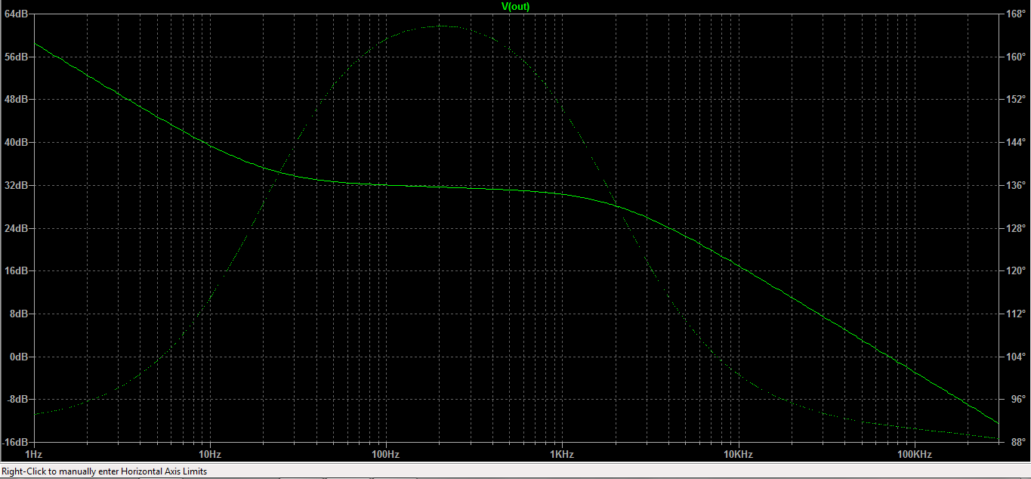
Simulation Results
This graph shows the gain vs the phase of the system output

Slide 29
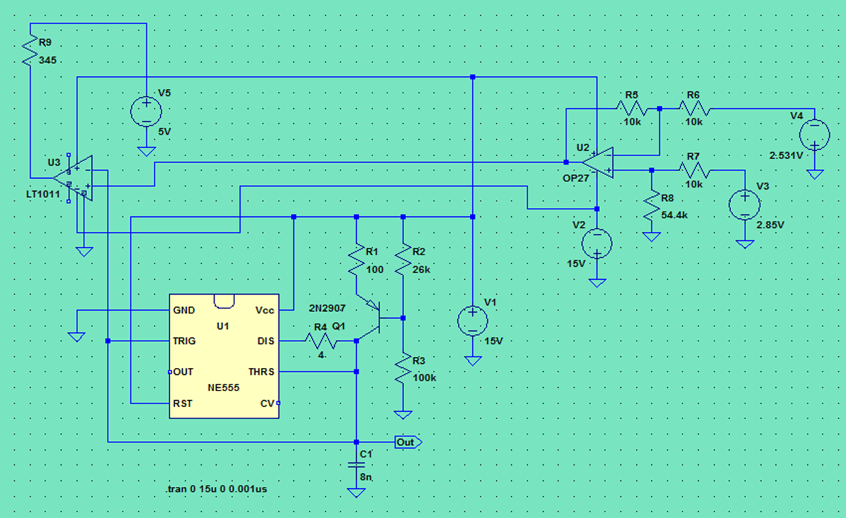
Pulse Width Modulation
To enhance the tracking performance of the PWM voltage controlled buck boost converter, an op amp and a 555timer network is used as a voltage controlled oscillator (VCO)
The 55timer will generate a triangular waveform which is passed to the inverting input of the comparator
By passing the input voltage to the non-inverting comparator input, a PWM waveform is produced.

Slide 30
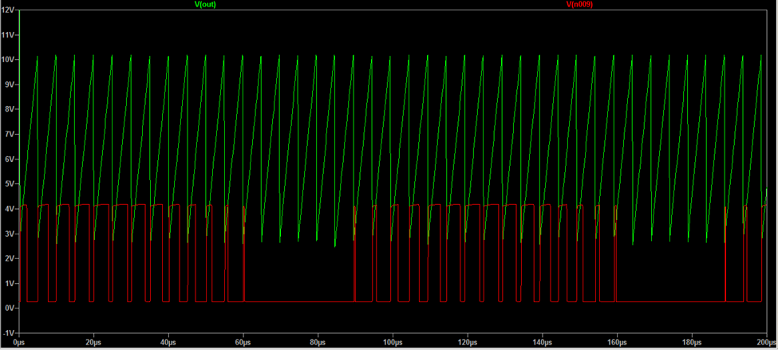
Simulation Results
The saw tooth is the output of the voltage controlled oscillator
The comparator generated pulsating waveform

Slide 31
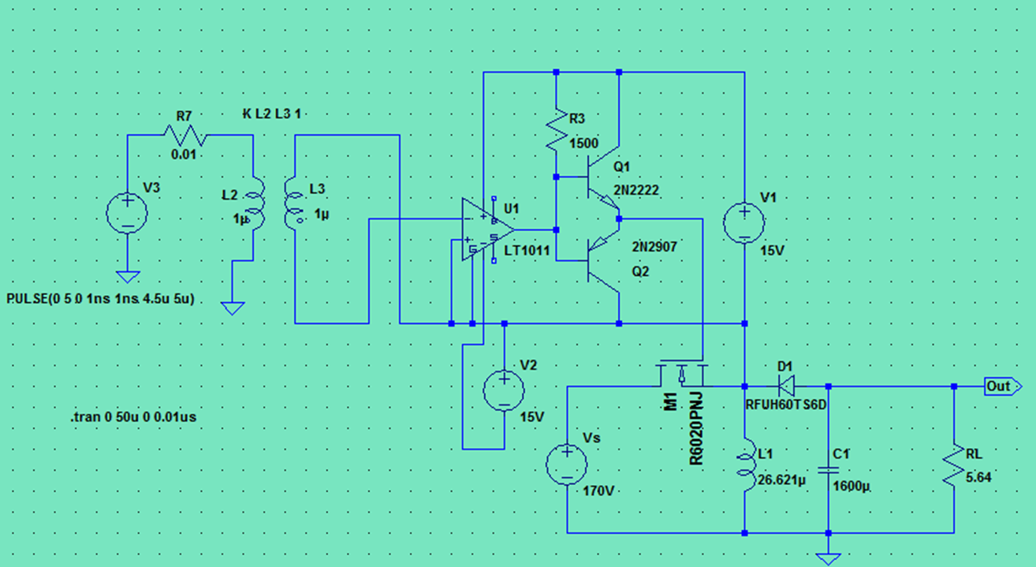
Gate Drive
In order for this system to operate it needs a switch that can handle a significant power levels to be able to work correctly.
For high frequencies, MOSFETs require a gate drive circuit to do the on/off operation at the desired frequency

Slide 32
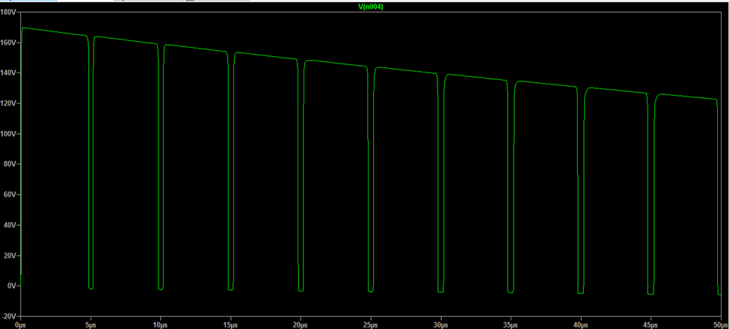
Simulation Results
During the on-time of the switch a small DC current flows keeping the gate in an on and off state.

Slide 33
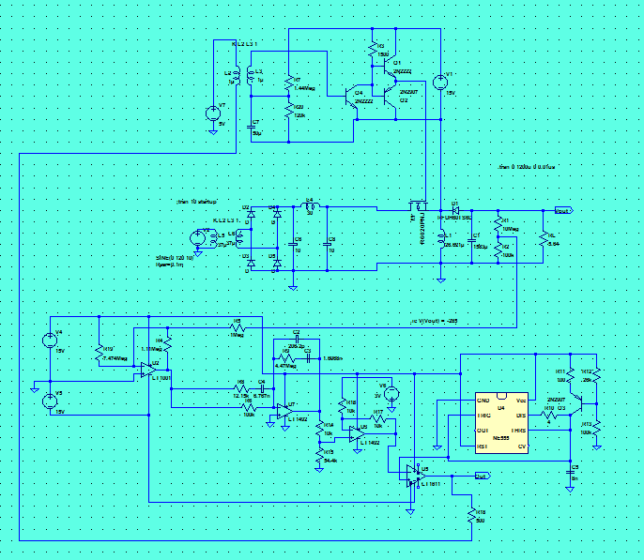
Full Circuit

Slide 34
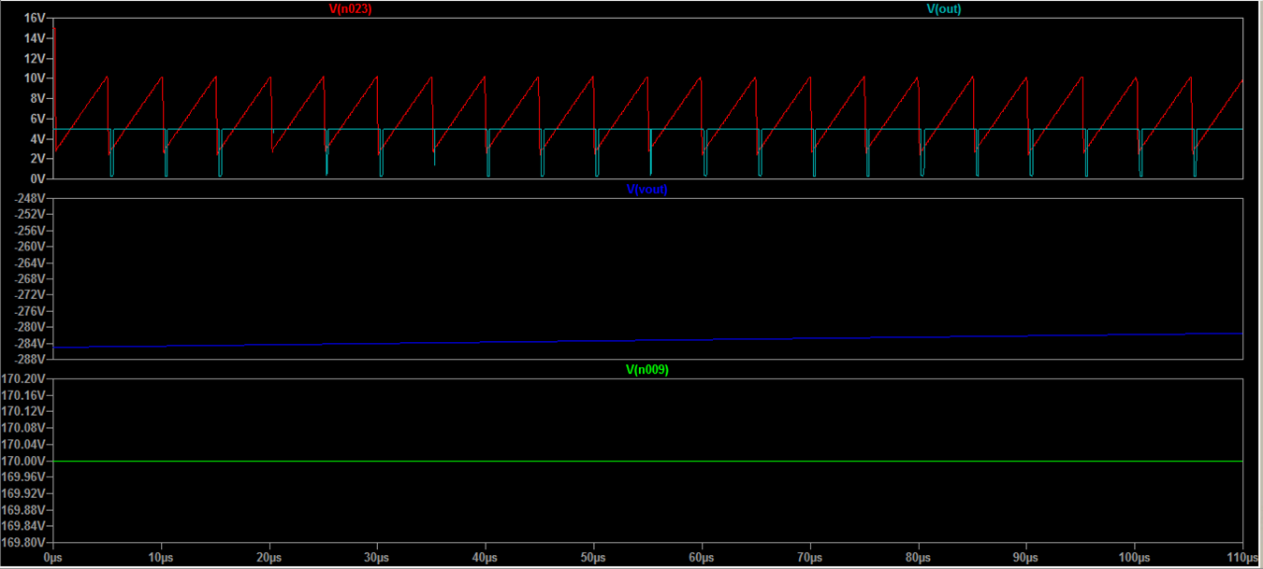
Simulation Results
Red= VCO output
Light blue= pulse widths
Blue output from the buck boost
Green=input voltage to the power supply

Slide 35
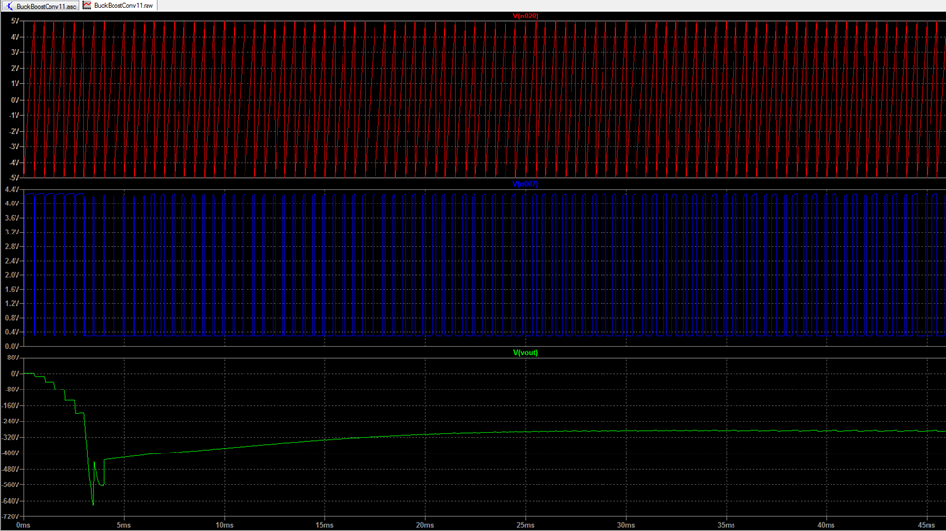
Simulation Results

Slide 36
Implementation of task 4
The Design of a pcb

Slide 37
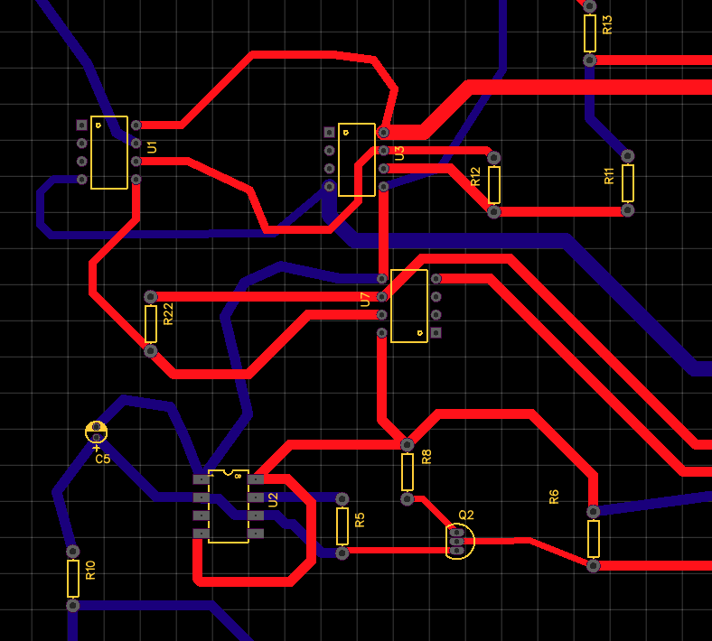
PCB Design

Slide 38
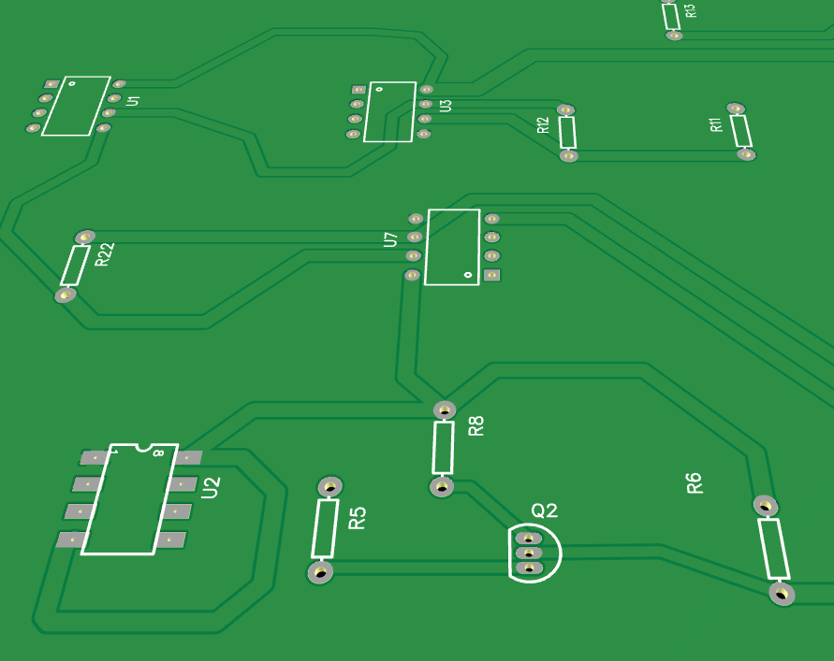
Photo view

Slide 39
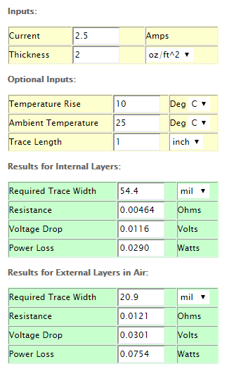
Online trace-width calculator

Slide 40
THE End
Questions/ Comments

Slide 41
Rectifier Overview
A rectifier is an electrical device composed of one or more diodes that converts alternating current (AC) to direct current (DC)
Current Technologies:
Silicon Controlled Rectifier (SCR)
Insulated Gate Bipolar Transistor (IGBT)
Metal Oxide Semi Conductor Field Effect Transistor (MOSFET)

Slide 42
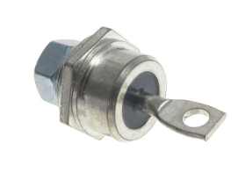
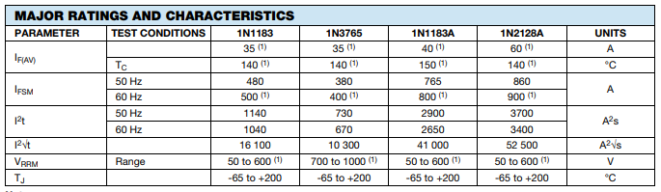
Selected Component
Power Diode: The selected power diodes that meet the parameters for this circuit are VS-1N1183A, manufactured by Vishay Semiconductors

Slide 43
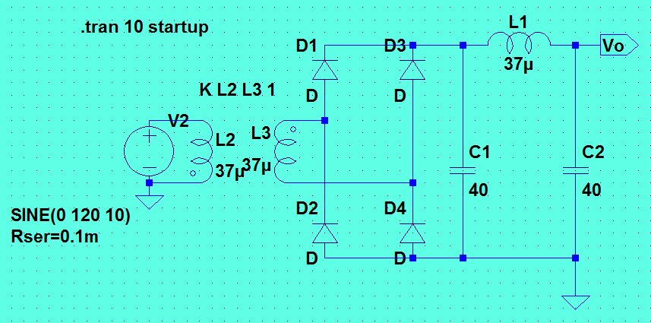
Spice simulation

Slide 44
Transfer function

Slide 45
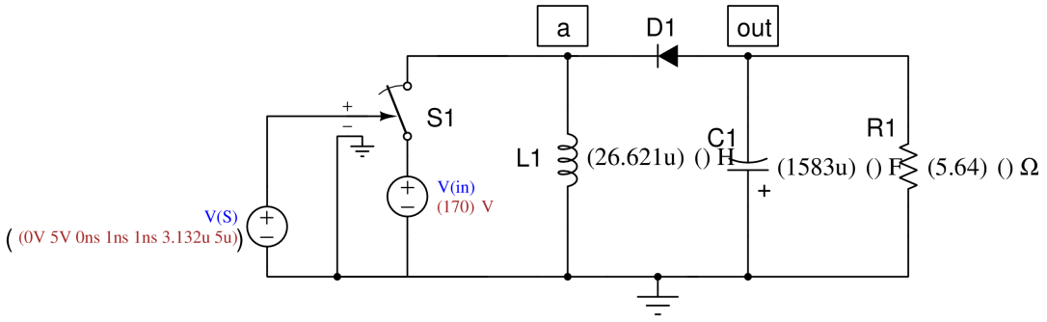
Spice Simulation
The circuit model shown below with calculated components values will be used for a SPICE simulation of the Buck-boost power supply

Slide 46
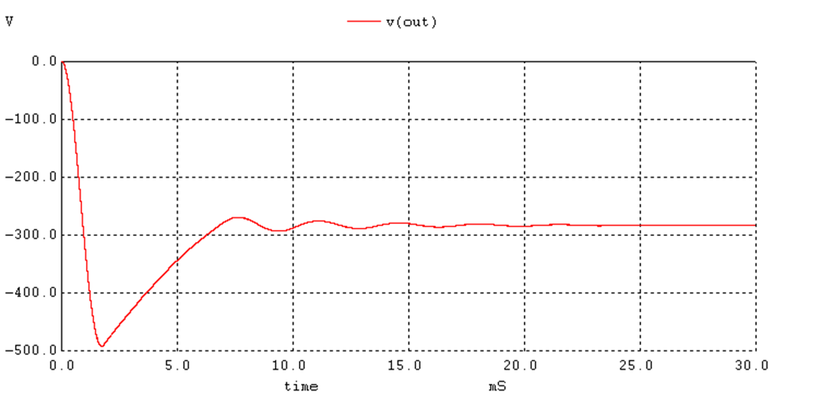
Voltage output

Slide 47


Slide 48
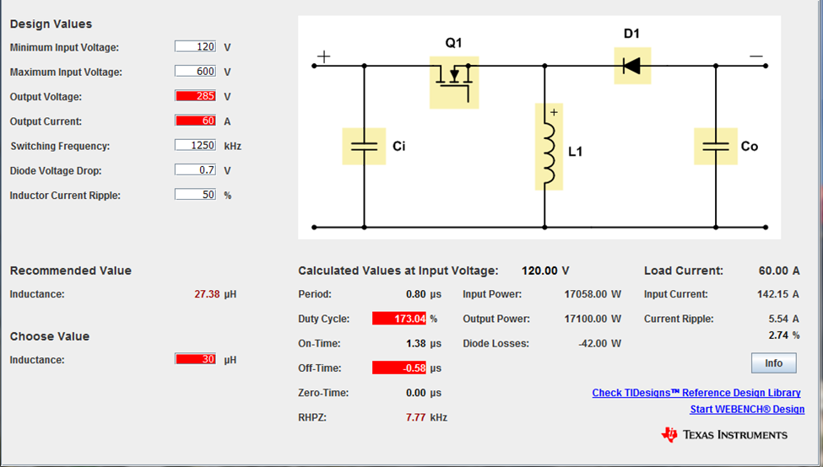
Ti power stage Disigner software

Slide 49
Next Assignments
Conduct further design simulations
Design a PCB
Obtain parts
Build a prototype

Slide 50
Acknowledgment
References
A. N. (2011, June 06). Power, Electronic Systems, Applications and Resources on Electrical and Electronic Project-Thesis. Retrieved December 04, 2017, from
Introduction of Three phase Half/Full Converter. (2017, January O5). Retrieved December 04, 2017, from https://www.pantechsolutions.net/powerelectronics-tutorials/introduction-of-three-phase-half-full-wave-converter
Tai-Ming, T. T. (1988, November). FIRING CIRCUITS FOR THREE-PHASE POWER ELECTRONIC CIRCUITS. Retrieved October, 2017.
CHAIJARURNUDOMRUNG, K, & AREERAK, K. (2011, April). Modeling and Stability Analysis of AC-DC Power System with Controlled Rectifier and Constant Power Loads. Retrieved November 04, 2017, from
Dr. Alvin Walker -Engineering Department
(UMES)

Slide 51
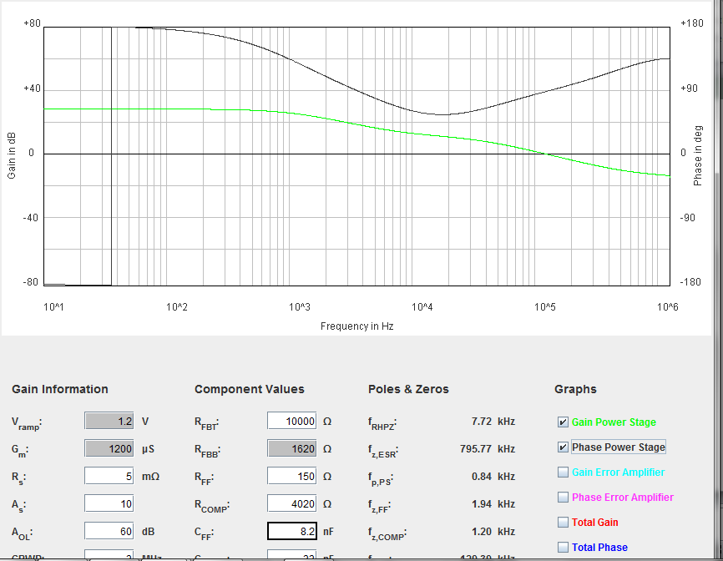
Gain power Phase Vs Phase Power Stage

Slide 52
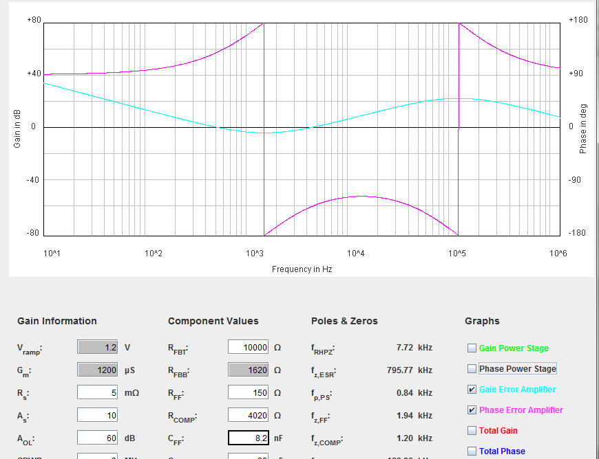
Gain error amp vs Phase error Amp

Slide 53
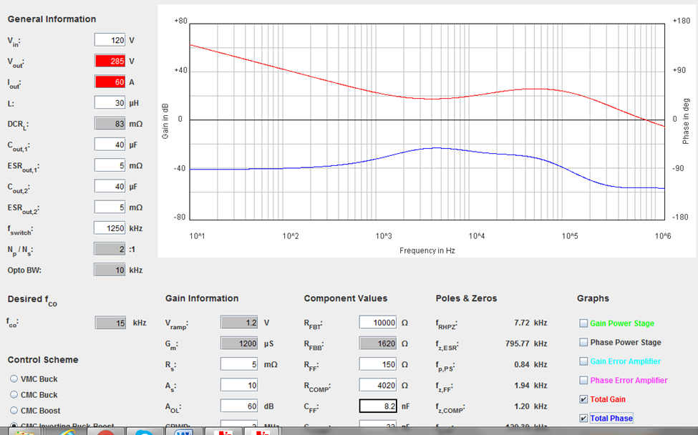
Total Gain Vs Total Phase

Slide 54
Week 6
03/27/2018

Slide 55
AC-dc power supply for welding machines
Senior Design Project
By Iragena Bangamwabo
Student -Electrical Engineering

Slide 56
Outline
Introduction
Objective
Design approach
Implementation of ask 6 (Calculating component values)
Design of compensator
Design of Voltage Control oscillator
Simulations

Slide 57
Introduction
A welding power supply is a device that provides electric current to perform a fusion of materials(usually metals or thermoplastics) by melting them, which requires a high current and high voltage.
Notes:
The focuses this project is to design a circuit that will serve as a power supply to in a welding machine.

Slide 58
Objective
The objective of this project is to design a circuit power supply that will take a wide range of AC input voltage and convert it into a steady DC output voltage.
Notes:
The objective of this project is to develop a power supply that will take a wide range of AC input voltage and convert it into a steady DC output voltage.

Slide 59
Design Requirements
AC input voltage range: 120V – 600V
Single or three phase, 50Hz or 60Hz
DC output voltage: 285V at a maximum continuous current of 60A
A circuit protection mechanism

Slide 60
Constraints
Budget – Estimated $1000
Limited Resources

Slide 61
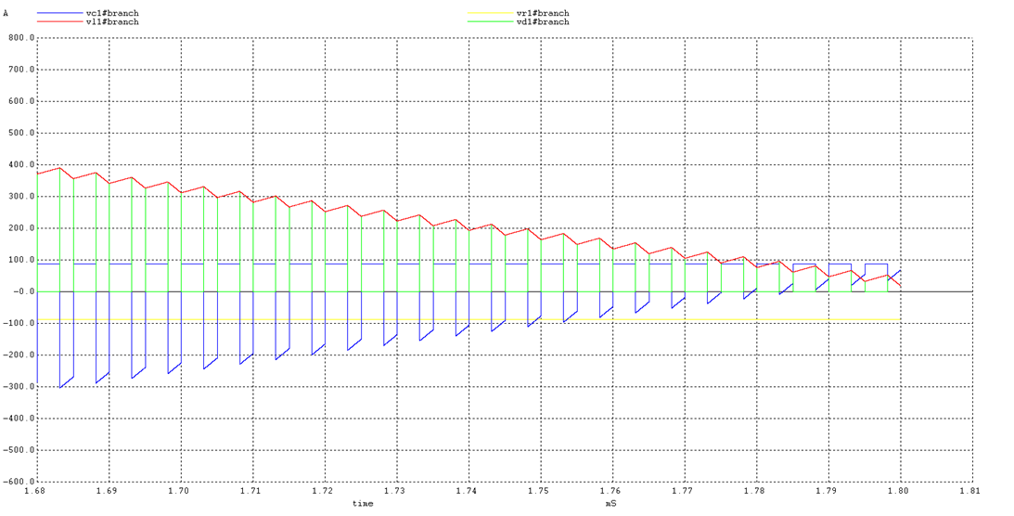
Converter Currents

Slide 62
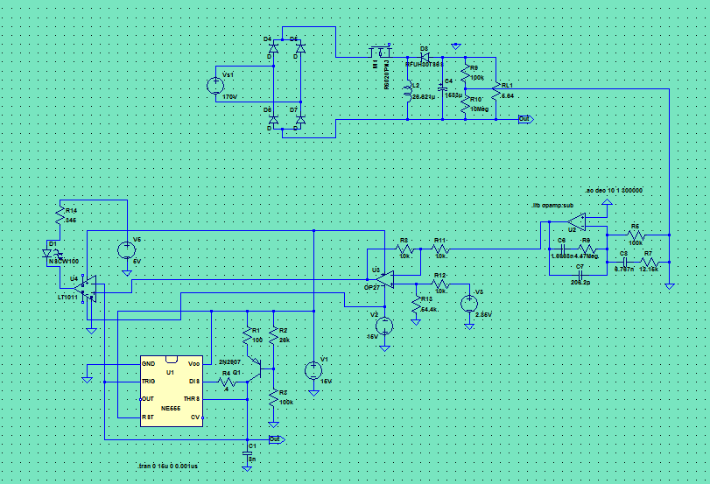
Circuitry Design Update

Slide 63
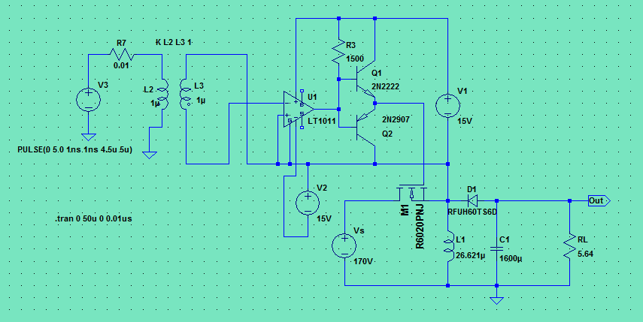
Gate Drive

